Slide 1
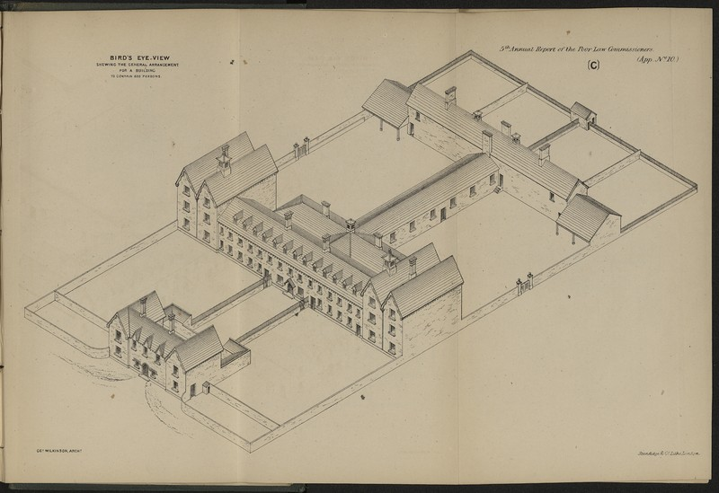
Stranorlar Workhouse & the Poor Law

Slide 2
The workhouse Collection at Donegal Co. Archives

Slide 3
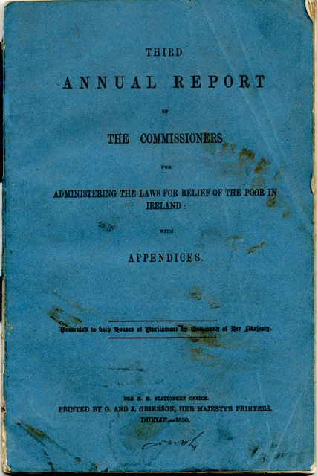
Poor Law Commissioners

Slide 4
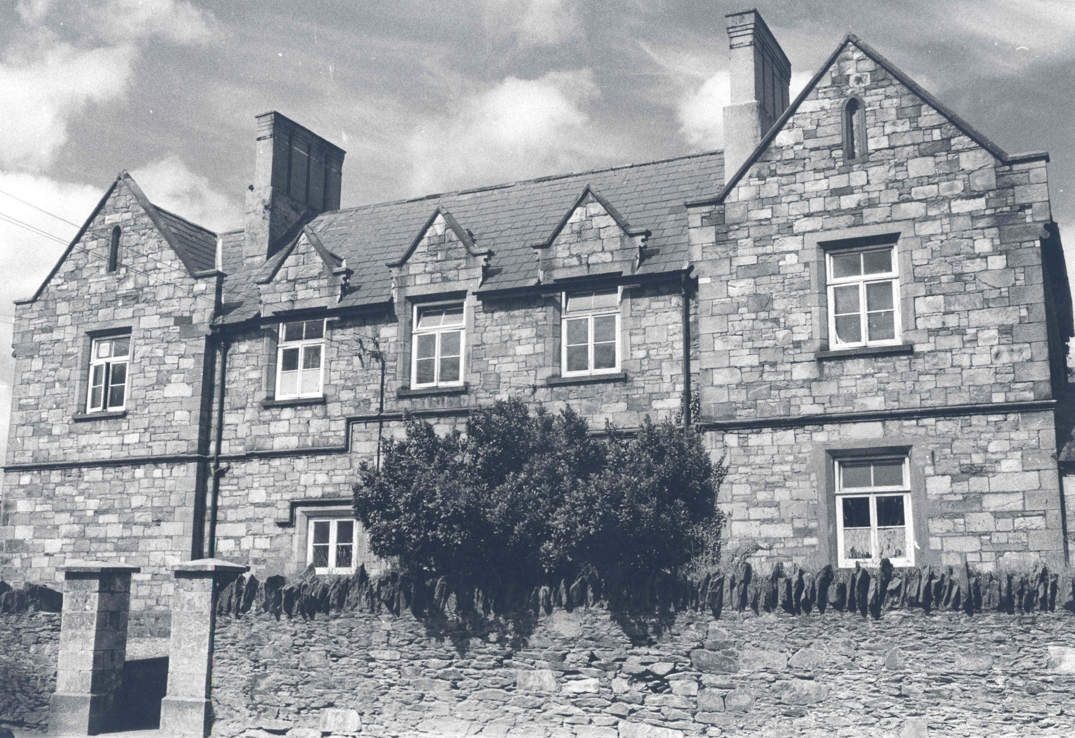
Letterkenny workhouse (now Co. Museum)

Slide 5
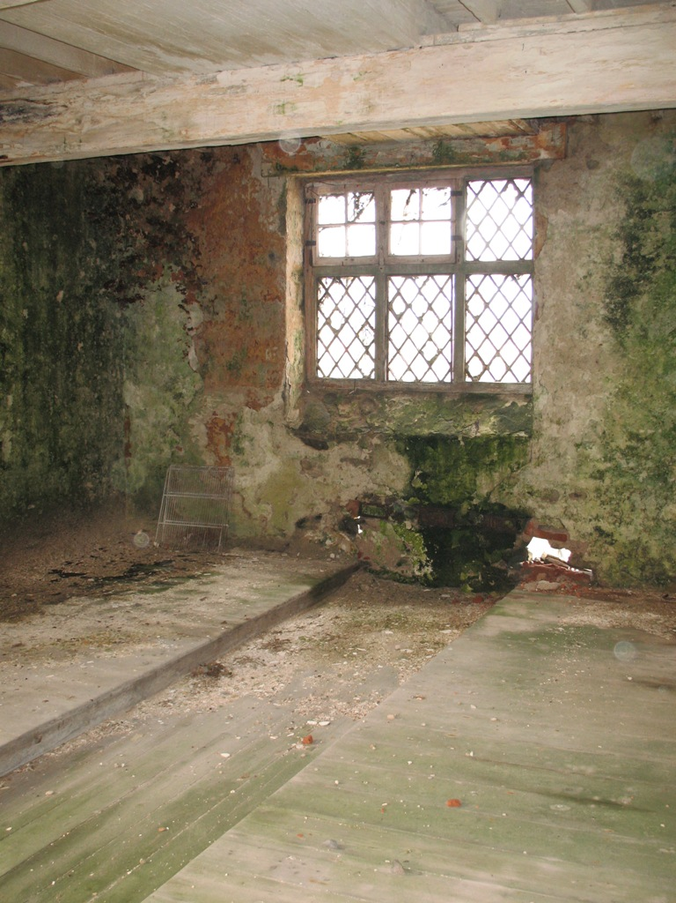
Ballyshannon workhouse, dorm, (2012)

Slide 6
Stranorlar Workhouse, first surviving minute book, 1845

Slide 7
Vaccinating against smallpox 1848

Slide 8
Stranorlar workhouse, Rates

Slide 10
The Great Famine

Slide 11
Diet in Stranorlar workhouse during Famine

Slide 12
Stranorlar workhouse medical officer report Feb 1847

Slide 13
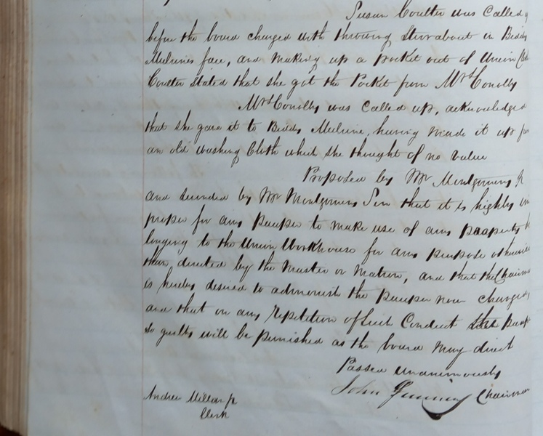
Stranorlar workhouse, punishments

Slide 14
Emigration of families from workhouses

Slide 15
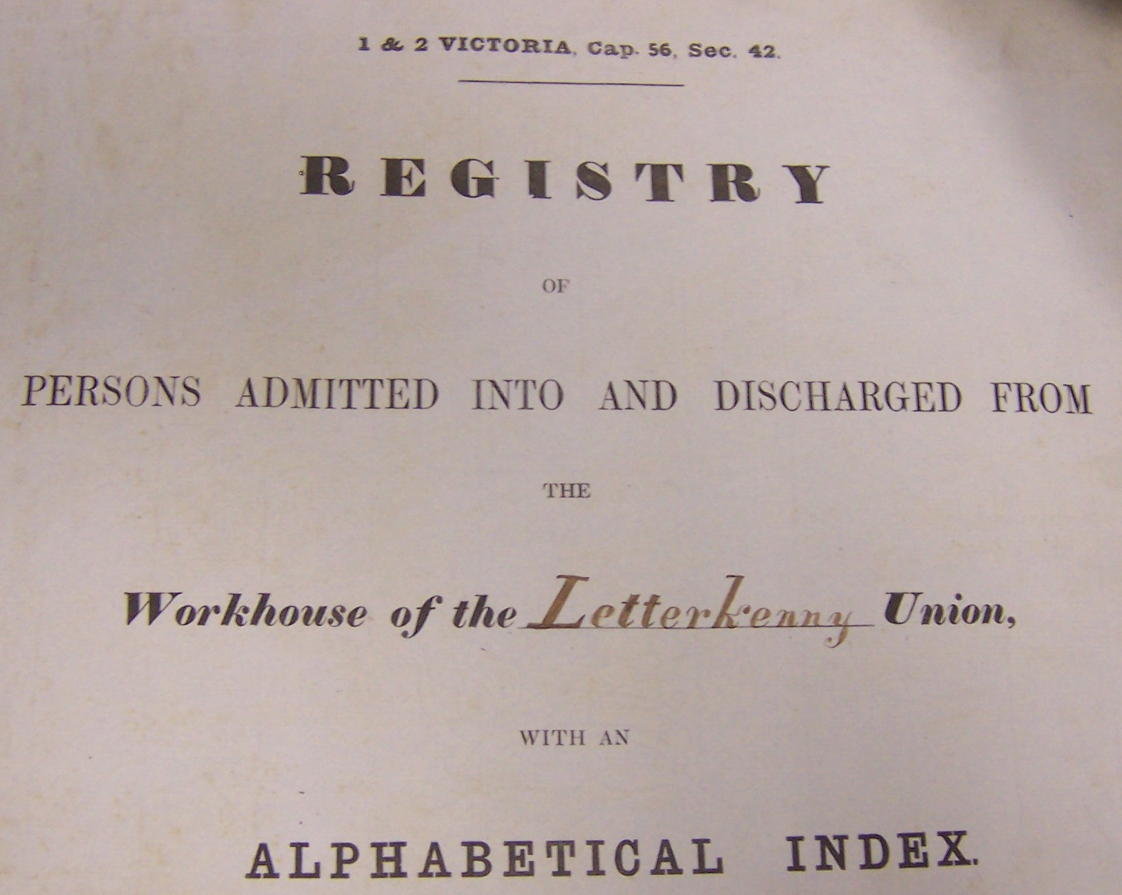

Slide 16
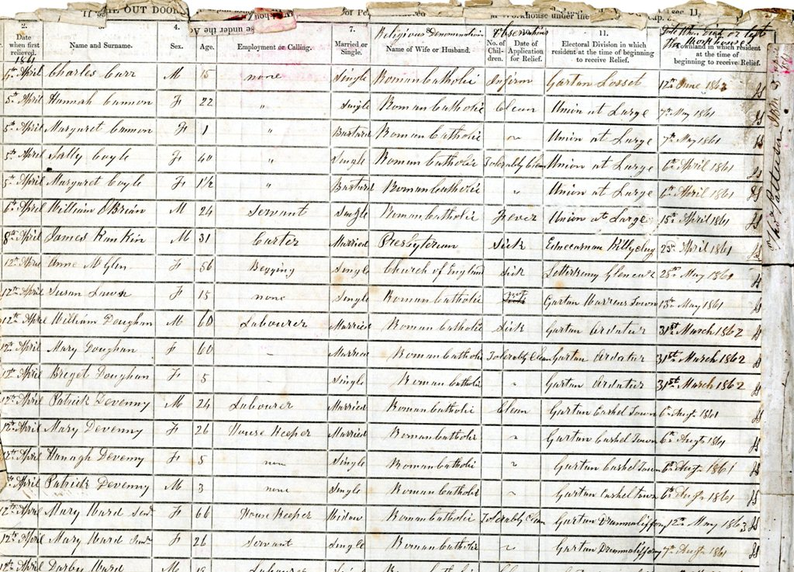

Slide 17
Dispensary ticket, Dunfanaghy

Slide 18
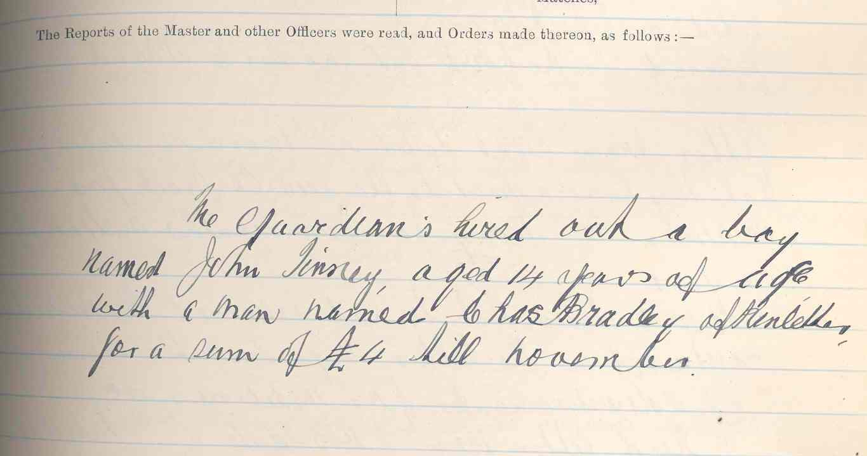
Children
Boarded out / at nurse & Hired Out

Slide 19
Children in/out of the workhouse

Slide 21
Mother & Baby Home Commission Report on Stranorlar Co Home – extract from chapter 29

Slide 24
Archives Service, Donegal County Council, Three Rivers Centre, Lifford, County Donegal Tel: +353 74 9172490 E-Mail: archivist@donegalcoco.ie Website: http://www.donegalcoco.ie/culture/archives/
www.facebook.com/DonegalCountyArchives
DonegalArchives @DonegalCoArchiv

